Slide 1
Dartmouth Travel Safety Policy Info Session: what you need to know before traveling internationally
Update for travelers and organizers of group travel to international destinations
Spring Term 2023

Slide 2
Travel Safety Policy revision(s)
Updated (significantly) in August 2019….
….then repeatedly revised during COVID-19
Most recent update April 17, 2023
The review/revision has been a collaborative process including:
Reviews of peer institution travel policies
Presentations to campus leadership bodies
Review of U.S. State Department (and similar) risk ratings and advisories
Development of shared resources for Dartmouth units with international travelers
The Travel Safety Working Group consists of representatives from the Provost’s Office, Risk Management, Office of General Counsel, Guarini Institute, Dickey Center, and graduate and professional schools as well as faculty input from Committee on Chairs

Slide 3
Unfortunately, the unexpected happens
Safety
Arrest or Deportation
Building Fire
Harassment
Sexual Harassment
Missing Person
Motor Vehicle Accident
Natural Disaster
Physical Assault
Sexual Assault
Theft or Robbery
Political Upheaval or Terrorist Event
Health
Illness requiring medical care
Injury requiring medical care
Outbreak of Disease
Pre-existing Mental and/or Physical Health Issues
Serious Behavioral/Psychological Concern
Unexpected Pregnancy
Death

Slide 4
Policy Scope
This policy applies to all Dartmouth Travelers and any Dartmouth Entity or individual organizing, administering, or funding Dartmouth Travel.
Dartmouth Entity: a Dartmouth department, program, or unit.
Dartmouth Traveler: all Dartmouth community members (students, faculty, staff, alumni, volunteers, and others who are participating in Dartmouth programs) participating in Dartmouth Travel.
Notes:
Dartmouth Travelers: All Dartmouth community members (students, faculty, staff, alumni, volunteers, and others who are participating in Dartmouth programs) participating in Dartmouth Travel.
Dartmouth Travel: Travel that Dartmouth requires, supports, supervises, controls, or manages, which is financially supported by Dartmouth or through any Dartmouth account, and/or is expected to result in the granting of academic credit from Dartmouth. This includes travel supported by external grants (e.g., from federal agencies or private foundations) made to Dartmouth.

Slide 5
Policy Scope
Dartmouth Travel: travel that Dartmouth requires, supports, supervises, controls, or manages, which is financially supported by Dartmouth or through any Dartmouth account, and/or is expected to result in the granting of academic credit from Dartmouth.
Notes:
Dartmouth Travel: Travel that Dartmouth requires, supports, supervises, controls, or manages, which is financially supported by Dartmouth or through any Dartmouth account, and/or is expected to result in the granting of academic credit from Dartmouth. This includes travel supported by external grants (e.g., from federal agencies or private foundations) made to Dartmouth.
Travel Exception: A required review of a Dartmouth Traveler's proposed plan to travel to a higher risk location. Higher risk locations are determined using travel risk assessments conducted by various international organizations, following the International SOS (ISOS) assessment most closely. A Travel Exception is either approved or declined by the Global Dartmouth team.
Travel Registry: Dartmouth's registration system used to assist in identifying the needs of Dartmouth Travelers in the event of an emergency. This includes facilitating delivery of support services.

Slide 6
Policy Scope
This includes travel supported by external grants (e.g., from federal agencies or private foundations) made to Dartmouth

Slide 7
Policy Purpose
Globally-Engaged Scholarship
Dartmouth is committed to supporting
domestic and international travel opportunities and
off-campus and experiential study, research, fieldwork,
community-based learning, internships, and other activities for all members of the Dartmouth community.
Dartmouth recognizes that its scholars are part of intellectual communities that span the globe, and supports its students, staff, and faculty to travel to perform scholarly work, attend scientific conferences, present their discoveries, serve as peer reviewers, and engage in other forms of academic and scholarly partnership.
Notes:
Dartmouth College (referred to in this Policy as "Dartmouth") is committed to supporting domestic and international travel opportunities and off-campus and experiential study, research, fieldwork, community-based learning, internships, and other activities for all members of the Dartmouth community. Dartmouth recognizes that its scholars are part of intellectual communities that span the globe, and supports its students, staff, and faculty to travel to perform scholarly work, attend scientific conferences, present their discoveries, serve as peer reviewers, and engage in other forms of academic and scholarly partnership.

Slide 8
Policy Purpose
Risk mitigation & Support
Supporting these activities requires managing risk and weighing the benefits to participants to maximize personal safety and compliance with regulations, while enhancing the academic experience and respecting commitments to our off-campus partners.

Slide 9
Travel Registration

Slide 10
Travel Registry
Travel Registry: Dartmouth's registration system used to assist in identifying the needs of Dartmouth Travelers in the event of an emergency. This includes facilitating delivery of support services.
Registration in the Travel Registry is required for all Dartmouth Travelers traveling outside of the United States.
https://global.dartmouth.edu/

Slide 11
Travel Exceptions

Slide 12
Travel Exceptions (formerly known as “Travel Waivers”)
Dartmouth prohibits Dartmouth Travel to certain destinations based on a variety of risk assessment factors (even if the traveler is from that country).
Dartmouth travel to these destinations is prohibited without a Travel Exception approved before departure.
Consult the Global Dartmouth webpage for current list of countries requiring an exception (varies whether traveler is an undergraduate student or any another Dartmouth traveler)

Slide 13
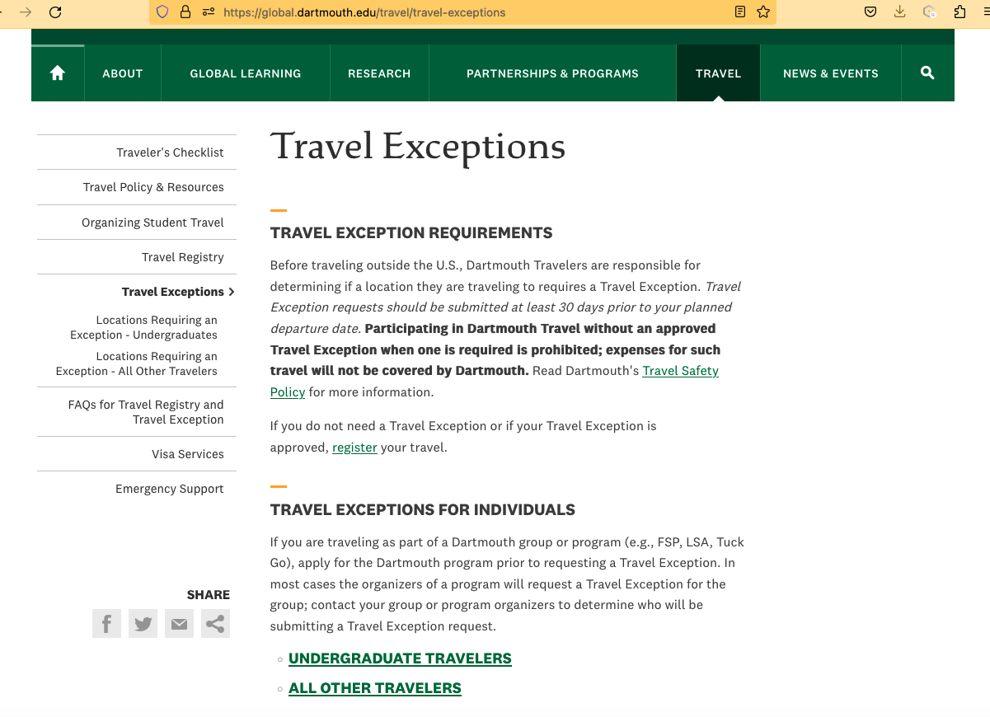
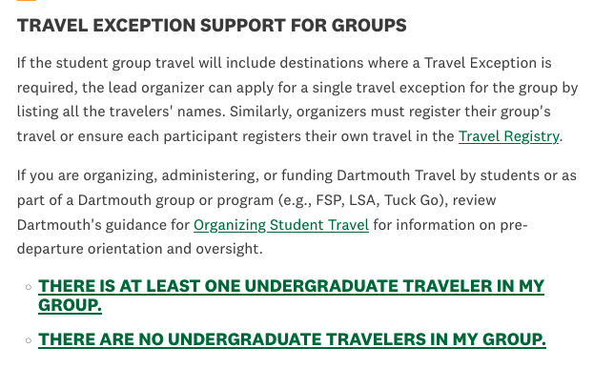
Short preamble
Links to country lists by traveler type (UG vs other)
Specific guidance for those organizing group travel (+/-UG included)

Slide 14
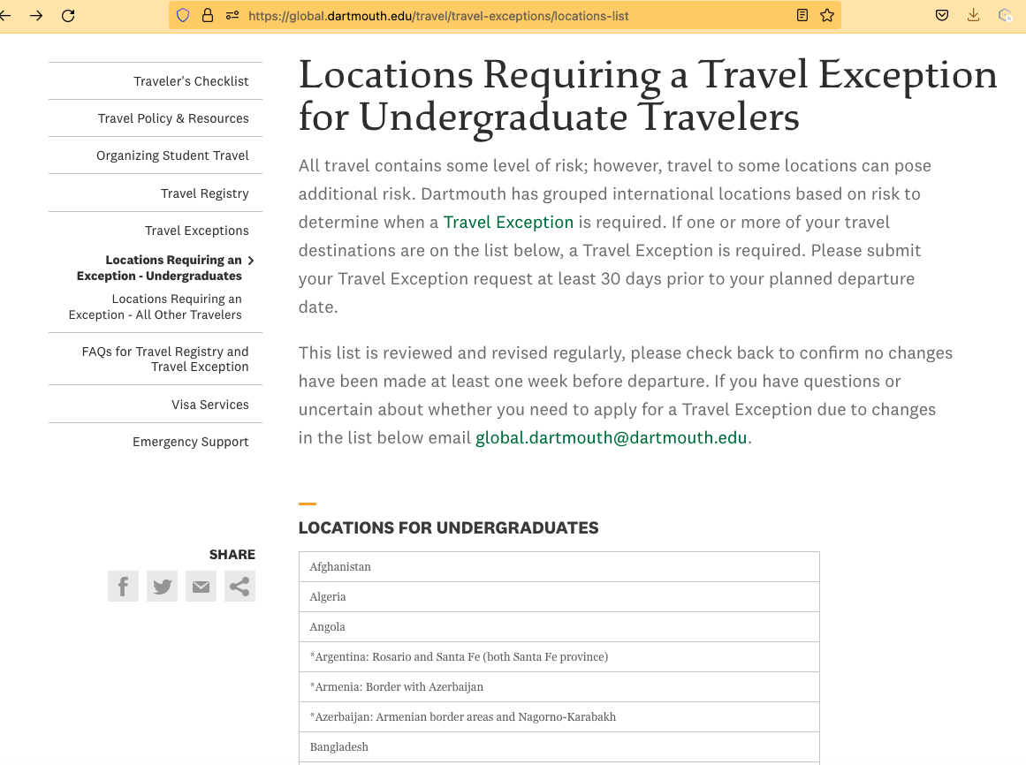
Short preamble
List of locations for which a travel exception is required
Country and/or high-risk locations within countries (more nuanced assessment)

Slide 15
Who and when for travel exceptions
The traveler is notified about their travel exception request ~1-2 weeks after submission
The exception request is a chance for the traveler to show they are aware of risks and have taken action to mitigate those risks (e.g., considered specific locations to avoid, have appropriate in-country contacts, have made emergency plans)
If above considerations are satisfied, approval is likely (most ARE approved)
We are working on a system to send notification to the Dartmouth entity supporting/sponsoring the the travel

Slide 16
2 tasks to comply! Funding/re-imbursement may be declined for noncompliance
Travelers only need to do TWO things before they travel to be compliant with the policy
1) Check if any of their destinations requires a travel exception, and if so, apply at least 30 days before departure.
2) Register their travel in the registry (if no exception required or once their exception request is approved)

Slide 17
Dartmouth Entity Requirements for student travelers

Slide 18
Requirements
The updated Travel Safety Policy requires all Dartmouth entities that organize, administer, and/or fund students on Dartmouth travel to provide:
specific pre-departure resources
overall oversight for their travelers
Notes:
ENTITIES ORGANIZING, ADMINISTERING, OR FUNDING STUDENT TRAVEL

Slide 19
Orientations & Pre-Departure
Best Practice:
In-person pre-departure orientation
At minimum:
Disseminate (and require students to review) the traveler resources on Global Dartmouth website prior to commencing their travel.
Sharable Resources can be found here: https://global.dartmouth.edu/travel/travel-policy-resources

Slide 20
Required Oversight: Policies & Procedures
Identify primary contact(s) for emergencies
Maintain clearly outlined response plan and protocols for emergencies

Slide 21
Required Oversight: Policies & Procedures
Provide participants with the following information:
Make sure all travelers are compliant with travel exception requests and approvals
Primary emergency contact and especially after-hours support.
Appropriate referrals for visa and passport services to ensure internationally-bound participants have the required permissions in connection with their travel on Dartmouth business.

Slide 22
Dartmouth After-Hours Support:
International SOS
-RM notified of ISOS calls
- Useful for medical & mental health needs and thefts, emergency cash (for a fee)
Safety & Security
- Reporting incidents

Slide 23
Required Oversight: Participant Records
Collect & maintain records of signed risk acknowledgement form (these can be shared from the Registry upon request
Maintain active record of travel itineraries, on-site contact details, and emergency contacts

Slide 24
Required Oversight: Participant Records
Ensure all students have registered their travel in the Travel Registry prior to travel
Only issue funding, academic credit, etc. AFTER the following have been received:
Travel exception approval (if required)
Risk acknowledgement form
Intended itinerary
Emergency and in-country contacts
Notice of filed travel registry

Slide 25
Resources: Via website
Global Dartmouth website
Group travel organizers and individual travelers can find the forms and resources they need on global.dartmouth.edu.
Pre-departure resources (safe traveler resources; visa and passport services; etc.)
Travel Exception requests & emergency supports
Travel Registry Link & forms for departments/programs (risk, emergency contacts, etc.)
If you have questions about Dartmouth’s travel policy and resources, please email us at Global.Dartmouth@Dartmouth.edu

Slide 26
Your questions??
(And time for a website tour?)

